Slide 1
HTML – Drag and Drop

Slide 2
HTML draggable Attribute
First of all: To make an element draggable, set the draggable attribute to true:
<p draggable="true">This is a draggable paragraph.</p>

Slide 3
<element draggable="true|false|auto">
Definition and Usage
The draggable attribute specifies whether an element is draggable or not.
Links and images are draggable by default.
The draggable attribute is often used in drag and drop operations.
true | Specifies that the element is draggable
false | Specifies that the element in not draggable
auto | Uses the default behaviour of the browser

Slide 4
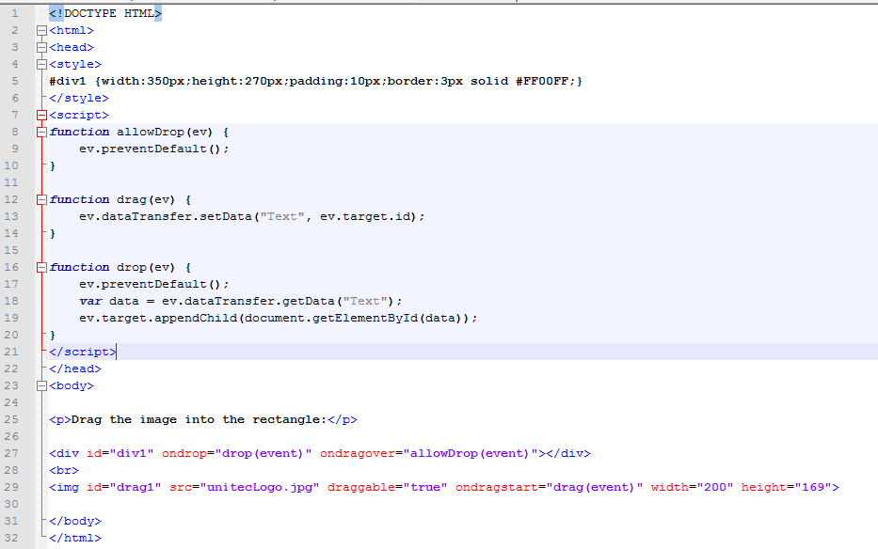

Slide 5
Make an Element Draggable
First of all: To make an element draggable, set the draggable attribute to true:
<img draggable="true">

Slide 6
What to Drag - ondragstart and setData()
Then, specify what should happen when the element is dragged.
In the example above, the ondragstart attribute calls a function, drag(event), that specifies what data to be dragged.
The dataTransfer.setData() method sets the data type and the value of the dragged data:
function drag(ev) { ev.dataTransfer.setData("Text", ev.target.id); }
In this case, the data type is "Text" and the value is the id of the draggable element ("drag1").

Slide 7
Where to Drop - ondragover
The ondragover event specifies where the dragged data can be dropped.
By default, data/elements cannot be dropped in other elements. To allow a drop, we must prevent the default handling of the element.
This is done by calling the event.preventDefault() method for the ondragover event:
event.preventDefault()

Slide 8
Do the Drop - ondrop
When the dragged data is dropped, a drop event occurs.
In the example above, the ondrop attribute calls a function, drop(event):
function drop(ev) { ev.preventDefault(); var data = ev.dataTransfer.getData("Text"); ev.target.appendChild(document.getElementById(data)); }

Slide 9
Code explained:
Call preventDefault() to prevent the browser default handling of the data (default is open as link on drop)
Get the dragged data with the dataTransfer.getData("Text") method. This method will return any data that was set to the same type in the setData() method
The dragged data is the id of the dragged element ("drag1")
Append the dragged element into the drop element

Slide 10
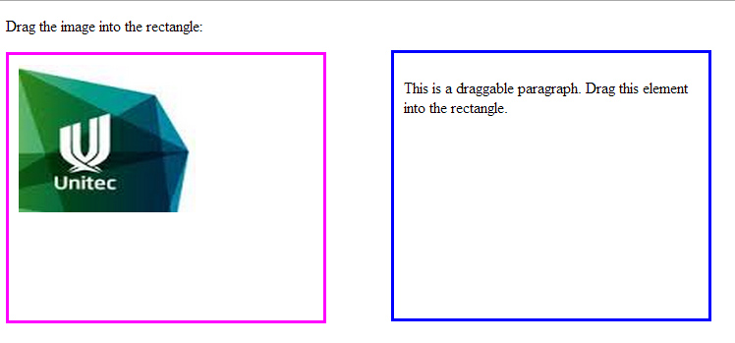
Example:

Slide 11
Add message on drop:
<div id="divMsg1">I appear on enter </div>
<div id="divMsg2">I appear on drop </div>
<div id="div1" ondrop="drop(event)" ondragover="allowDrop(event)" ondragenter="enter(event)"></div>

Slide 12
function drag(ev) {
ev.dataTransfer.setData("Text", ev.target.id);
document.getElementById("divMsg2").style.visibility="hidden";
document.getElementById("divMsg1").style.visibility="hidden";
}
function drop(ev) {
ev.preventDefault();
var data = ev.dataTransfer.getData("Text");
ev.target.appendChild(document.getElementById(data));
document.getElementById("divMsg2").style.visibility="visible";
}
function enter(e) {
document.getElementById("divMsg1").style.visibility="visible";
return true;
}

Slide 13
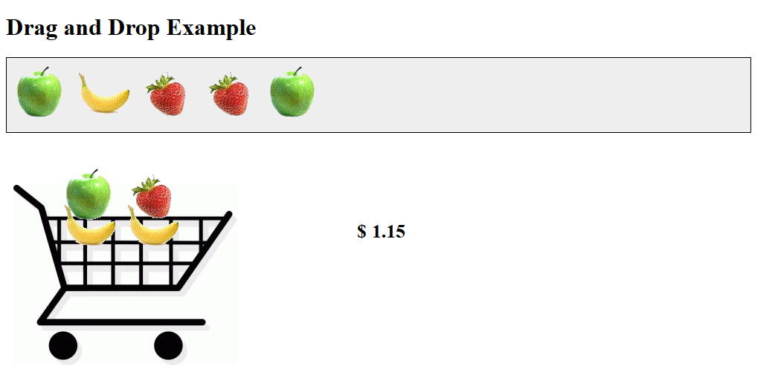
http://www.webbingways.com/bookfiles/chapter8/codelisting_8_3.html

Slide 14
<h1>Drag and Drop Example</h1>
<div id="shelf" ondrop="drop(this, event, 'shelf')" ondragenter="return false" ondragover="return false">
<div draggable="true" id="apple1" class="fruit" ondragstart="drag(this, event)"><img src="images/apple.gif" alt="apple" "=""></div>
<div draggable="true" id="apple2" class="fruit" ondragstart="drag(this, event)"><img src="images/apple.gif" alt="apple" "=""></div>
<div draggable="true" id="apple3" class="fruit" ondragstart="drag(this, event)"><img src="images/apple.gif" alt="apple" "=""></div>
<div draggable="true" id="banana1" class="fruit" ondragstart="drag(this, event)"><img src="images/banana.gif" alt="banana" "=""></div>
<div draggable="true" id="banana2" class="fruit" ondragstart="drag(this, event)"><img src="images/banana.gif" alt="banana" "=""></div>
<div draggable="true" id="strawberry1" class="fruit" ondragstart="drag(this, event)"><img src="images/strawberry.gif" alt="strawberry" "=""></div>
</div>

Slide 15
<div id="shoppingcart" class="container">
<div id="shoppingcartcenter"
ondrop="drop(this, event, 'shoppingcart')" ondragenter="return false" ondragover="return false"></div>
<img src="images/shoppingcart.png" alt="shopping cart" "=""></div>

Slide 16
function drag(drag_object, e) {
e.dataTransfer.setData('Text', drag_object.id);
}

Slide 17
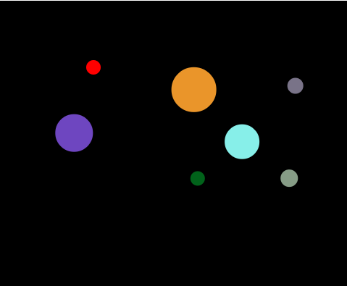
Drag and Drop on Canvas

Slide 18
Functions:
mouseDownListener(evt)
getting mouse position correctly, find which shape was clicked
mouseMoveListener(evt)
getting mouse position correctly, check that is not out of canvas
mouseUpListener(evt)
reset for next mousedown

Slide 19
Other functions
hitTest(shape,mx,my)
makeShapes() –to fill our array with shapes
drawShapes() draw all shapes from our array on canvas
drawScreen() update canvas

Slide 20
Resources:
http://ie.microsoft.com/testdrive/Graphics/CanvasPad/Default.html
http://www.w3schools.com/tags/att_global_draggable.asp
http://www.w3schools.com/html/html5_draganddrop.asp
http://html5doctor.com/native-drag-and-drop/
https://www.codeproject.com/Articles/226193/cross-browser-drag-and-drop
https://www.codeproject.com/Articles/1091766/Add-support-for-standard-HTML-Drag-and-Drop-operat
https://www.html5rocks.com/en/tutorials/dnd/basics/

